Slide 1
Cloud Security

Slide 2
Introduction to Cloud Computing
Cloud computing is an on-demand delivery of IT capabilities where IT infrastructure and applications are provided to subscribers as a metered service over a network.
Characteristics of Cloud Computing:
On-demand self-service
Distributed storage
Rapid elasticity
Automated management
Broad network access
Resources pooling
Measured service virtualization technology

Slide 3
Types of Cloud Computing Services
Infrastructure-as-a-Service (IaaS)
Platform-as-a-Service (PaaS)
Software-as-a-Service (IaaS)
Identity-as-a-Service (IDaaS)
Security-as-a-Service (SECaaS)
Container-as-a-Service (CaaS)
Function-as-a-Service (FaaS)

Slide 4
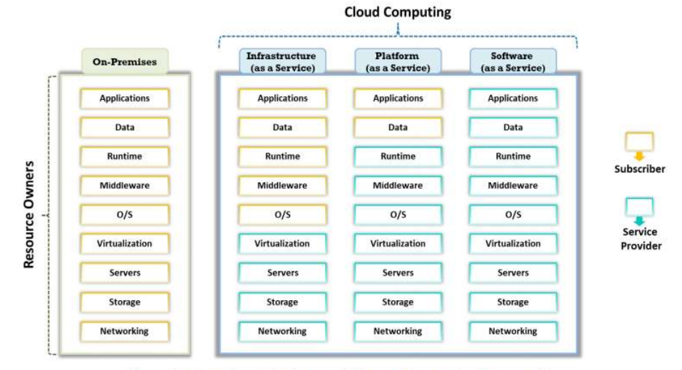
Separation of Responsibilities in Cloud (Shared Responsibility Model)

Slide 5
Cloud Deployment Models
Public Cloud
Private Cloud
Community Cloud
Hybrid Cloud
Multi Cloud
Distributed cloud

Slide 6
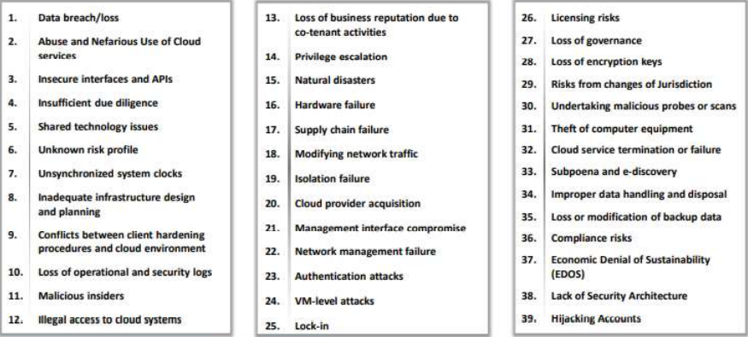
Cloud Computing Threats

Slide 7
CSP Native Service Nomenclature (The Multi-Cloud Rosetta Stone)
Why nomenclature matters.
The "Naming" Paradox: In the cloud, names are often marketing-driven, not technical. For example, a "Bucket" (AWS) is a "Container" (Azure) which is a "Bucket" again (GCP).
Architectural Equivalence: Most services across providers follow the same underlying distributed systems principles.
The Risk: Miscommunication between teams, incorrect service selection, and slowed migration.
The Goal: To enable "Cloud Fluency"—the ability to translate a business requirement into the specific native service of any provider without loss of meaning.
Same services have different names across CSPs
Purpose: Avoid confusion during cloud operations
Storage: Amazon S3 vs Azure Blob vs GCP Cloud Storage
IAM: AWS IAM vs Azure Entra ID vs GCP IAM
Working: Services perform similar security functions

Slide 8
Storage Services (Storing unstructured data at scale)
Feature | AWS: Amazon S3 | Azure: Blob Storage | GCP: Cloud Storage
Top-Level Unit | Bucket (Globally unique name) | Storage Account (Contains Containers) | Bucket (Globally unique name)
Data Unit | Object | Blob (Block, Append, Page) | Object
Key Advantage | Most mature; S3 API is the industry standard for 3rd parties. | Deeply integrated with Windows/AD; strong for "Data Lakes." | Best-in-class global consistency; very simple pricing tiers.

Slide 9
Virtual Compute & Modern Scaling
Provisioning raw power vs. managed platforms.
Virtual Machines (IaaS):
AWS (EC2): Uses "Instance Types" (e.g., t3.medium). Highly customizable but can be complex to navigate.
Azure (VMs): Classified by "Series" (e.g., D-Series for general purpose). Very familiar to Windows Server admins.
GCP (Compute Engine): Unique "Custom Machine Types" allow you to pick exact CPU/RAM ratios rather than fixed sizes.
Serverless (FaaS):
AWS Lambda: The pioneer. Best ecosystem for event triggers.
Azure Functions: Strongest for developers using C# or VS Code integration.
GCP Cloud Functions: Built on Knative; highly portable and simple to deploy.

Slide 10
Networking & Security Boundaries
How environments are isolated and connected.
Private Networks:
AWS VPC: Region-specific. You must "peer" VPCs across regions.
Azure VNet: Region-specific, similar to AWS.
GCP VPC: Global by design. A single GCP VPC can span multiple continents, simplifying global architecture.
Identity (IAM):
AWS IAM: Uses "Users," "Groups," and "Roles." Very granular.
Azure Entra ID: (Formerly Active Directory). Centralized identity for the whole enterprise (Office 365, etc.).
GCP IAM: Projects are the core unit. Policies are inherited from the "Organization" or "Folder" level.

Slide 11
Security Governance & Identity Structure
Understanding the hierarchy of control for Identity and Access Management (IAM) across providers.
Comparison of Organizational Hierarchies:
AWS: Managed via AWS Organizations, utilizing Accounts as the primary boundary and Service Control Policies (SCPs) for top-down governance.
Azure: Uses a Tenant as the top level, with management through Subscriptions and Resource Groups.
GCP: Structured by Organization → Folders → Projects, where permissions are inherited downward.
OCI: Uses Tenancy and Compartments to logically isolate resources for security and billing.

Slide 12
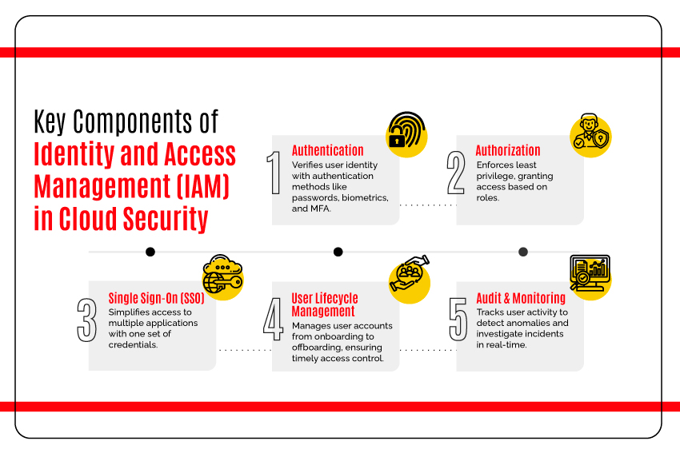
Identity and Access Management (IAM)
Controls authentication and authorization in cloud
Purpose: Ensure least privilege access
AWS: Account → IAM Users/Roles
Azure: Tenant → Subscription → RBAC
GCP: Organization → Project → IAM Roles
Policies define who can do what on which resource

Slide 13
Identity and Access Management (IAM)
A comparison of how each provider organizes its logical boundaries and management structures.
CSP | Top-Level Boundary | Secondary Level | Primary Unit for Resources
AWS | Organization | Organizational Unit (OU) | Account
Azure | Tenant (Entra ID) | Management Group | Subscription
GCP | Organization | Folder | Project
OCI | Tenancy | Parent Compartment | Compartment

Slide 14
Cloud Endpoint Protection & Vulnerability Management
Securing the "compute" layer from malware and known exploits.
Endpoint Detection & Response (EDR):
Azure: Features Microsoft Defender for Endpoint, providing advanced threat protection and post-breach detection.
AWS & GCP: Often rely on specialized marketplace partners or native integrations with security agents.
Vulnerability Scanning:
AWS: Uses Amazon Inspector, which automatically discovers and scans EC2 instances and container images for software vulnerabilities.
Azure: Integrated into Microsoft Defender for Cloud, providing continuous scanning of server workloads.

Slide 15
Cloud Security Posture Management (CSPM)
Identifying misconfigurations (like open S3 buckets) and ensuring compliance with industry standards (CIS, NIST).
Native CSPM Tools:
AWS: Uses AWS Config to track resource changes and evaluate them against "Config Rules" to detect non-compliance.
Azure: Managed through Microsoft Defender for Cloud, which provides a "Secure Score" to quantify your current security posture.
Oracle (OCI): Features Oracle CloudGuard, which monitors the tenancy for risky configurations and anomalous activities.

Slide 16
Cloud Logging – Unified Security Monitoring (SIEM/XDR)
Aggregating logs and alerts to respond to complex attacks.
The “Big Three" Solutions:
AWS: Amazon GuardDuty (Threat Detection) and AWS Security Hub (Centralized dashboard for all security alerts).
Azure: Microsoft Sentinel, a cloud-native SIEM that integrates directly with Defender for Cloud for rapid response.
GCP: Google Security Operations (formerly Chronicle), designed for massive-scale log ingestion and sub-second searching.

Slide 17
Log Types and Collection
Understanding what data is collected is essential for audit, forensics, and operational health.
Operating System Logs: System-level events (e.g., startup, errors) recorded in Windows (Event Viewer) and Linux (/var/log).
Audit Logs: Records of user actions, such as data access, configuration changes, and system setting modifications for compliance tracking.
Object Storage Access Logs: Detailed logs tracking requests made to storage buckets (e.g., S3 Server Access Logs or Azure Blob Storage logging).
WAF Logs: Logs from Web Application Firewalls that record incoming traffic patterns to detect and block malicious requests.

Slide 18
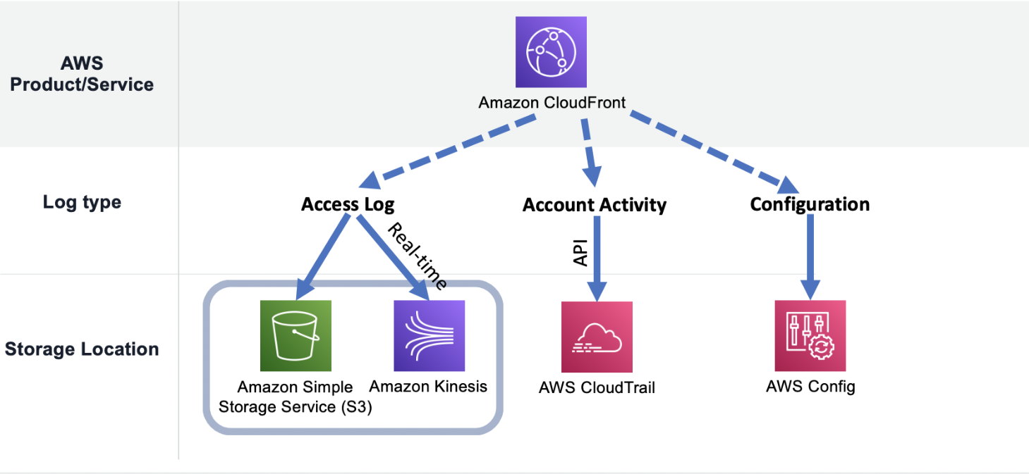
Log Aggregation – AWS
CloudTrail records API activity
CloudWatch Logs collect system logs
Amazon S3 used for centralized storage
Working: Logs forwarded to SIEM for analysis

Slide 19
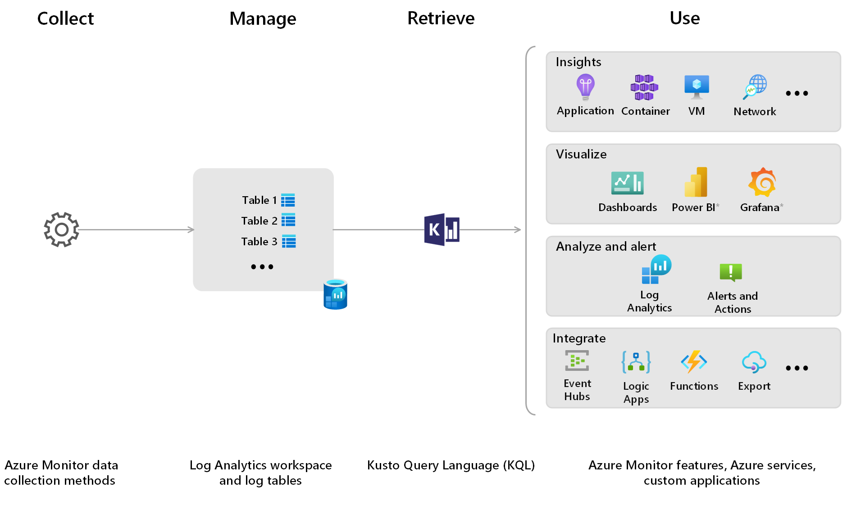
Log Aggregation – Azure
Azure Monitor collects platform logs
Log Analytics Workspace stores logs
Event Hub streams logs to SIEM
Working: Integrated with Microsoft Sentinel

Slide 20
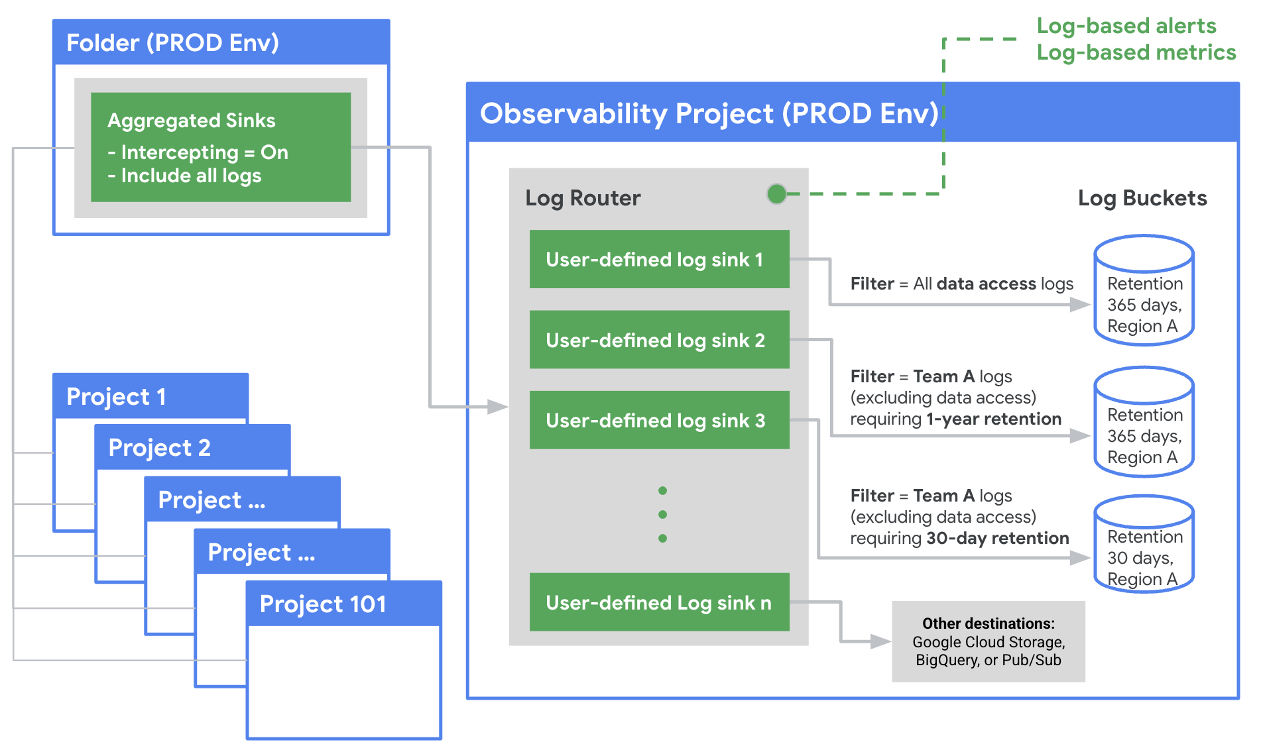
Log Aggregation – GCP
Cloud Logging centralizes all logs
Supports VM, container, and service logs
Logs can be exported to SIEM
Working: Enables threat detection and investigations

Slide 21
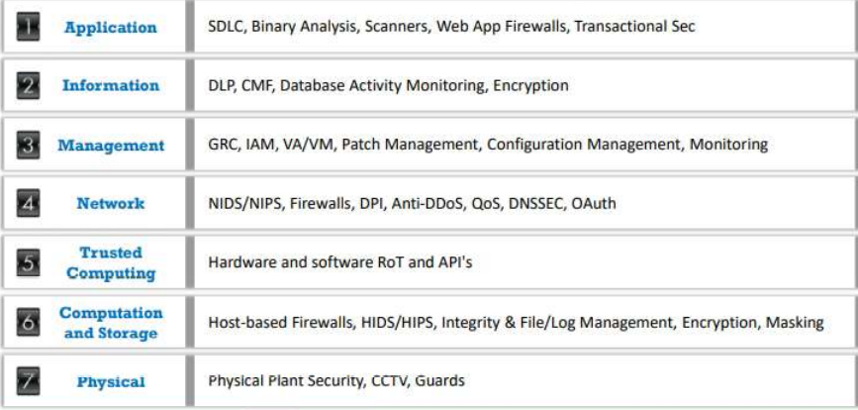
Cloud Security Control Layers

Slide 22
What is Cloud Hacking?
Attackers exploit vulnerabilities existing in the cloud technologies to perform various targeted high-profile attacks on cloud storage systems, compromising the corporate and customers’ data.
The main objective of hacking the cloud environment is gaining access to user’s data and blocking access to cloud services.

Slide 23
Is Cloud Computing Secure?
For most organizations, the journey to cloud is no longer a question of “if” but rather “when”, and a large number of enterprises have already travelled some way down this path.
Is cloud computing secure?
A simple answer is: Yes, if you approach cloud in the right way, with the correct checks and balances to ensure all necessary security and risk management measures are covered.

Slide 24
Is Cloud Computing Secure?
Companies ready to adopt cloud services are right to place security at the top of their agendas.
the consequences of getting your cloud security strategy wrong could not be more serious.
As many unwary businesses have found to their cost in recent high-profile cases, a single cloud-related security breach can result in an organization severely damaging its reputation – or, worse, the entire business being put at risk.

Slide 25
Is Cloud Computing Secure?
Those further along their cloud path are finding that, like all forms of information security, the question boils down to effective risk management.
we outlined the different layers in the cloud services stack:
Infrastructure-as-a-Service (IaaS)
Platform-as-a-Service (PaaS)
Software-as-a-Service (SaaS)
Business Process-as-a-Service (BPaaS).
These layers – and their associated standards, requirements and solutions – are all at different levels of maturity.

Slide 26
Is Cloud Computing Secure?
The world of business is becoming more uncertain, as with new system architectures come new cyber threats. No longer can the mechanisms deployed in the past be relied on for protection”
--Nick Gaines, Group IS Director, Volkswagen UK
Different types of cloud have different security characteristics. The table in next page shows a simple comparison. (The number of stars indicates how suitable each type of cloud is for each area.)
We choose to characterize these types as private, public and community clouds – or “hybrid” to refer to a combination of approaches.

Slide 27
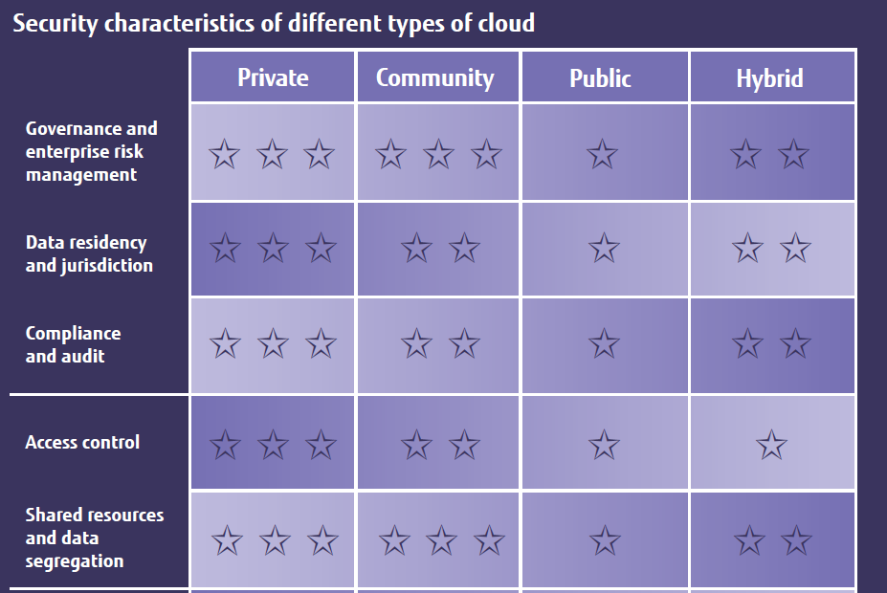
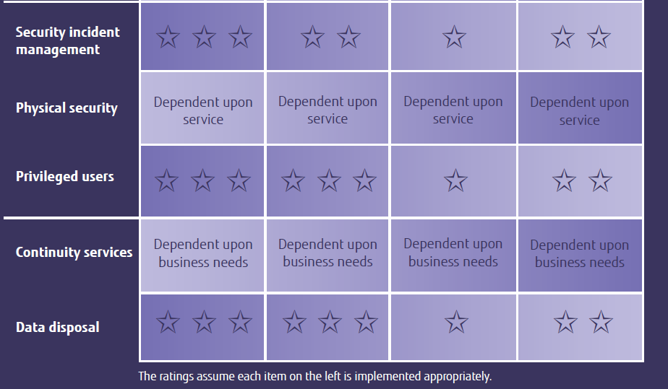
Security Characteristics

Slide 28
Security Risks
Organizations with defined controls for externally sourced services or access to IT risk-assessment capabilities should still apply these to aspects of cloud services where appropriate.
But while many of the security risks of cloud overlap with those of outsourcing and offshoring, there are also differences that organizations need to understand and manage.
“When adopting cloud services, there are four key considerations:
1. Where is my data?
2. How does it integrate?
3. What is my exit strategy?
4. What are the new security issues?”
--Tony Mather, CIO, Clear Channel International

Slide 29
Security Risks
Processing sensitive or business-critical data outside the enterprise introduces a level of risk because any outsourced service bypasses an organization's in-house security controls. With cloud, however, it is possible to establish compatible controls if the provider offers a dedicated service. An organisation should ascertain a provider’s position by asking for information about the control and supervision of privileged administrators.
Organizations using cloud services remain responsible for the security and integrity of their own data, even when it is held by a service provider. Traditional service providers are subject to external audits and security certifications. Cloud providers may not be prepared to undergo the same level of scrutiny.
When an organisation uses a cloud service, it may not know exactly where its data resides or have any ability to influence changes to the location of data.

Slide 30
Security Risks
Most providers store data in a shared environment. Although this may be segregated from other customers’ data while it’s in that environment, it may be combined in backup and archive copies. This could especially be the case in multi-tenanted environments.
Companies should not assume service providers will be able to support electronic discovery, or internal investigations of inappropriate or illegal activity. Cloud services are especially difficult to investigate because logs and data for multiple customers may be either co-located or spread across an ill-defined and changing set of hosts.
Organisations need to evaluate the long-term viability of any cloud provider. They should consider the consequences to service should the provider fail or be acquired, since there will be far fewer readily identifiable assets that can easily be transferred in-house or to another provider.

Slide 31
Cloud Security Simplified
As with all coherent security strategies, cloud security can seem dauntingly complex, involving many different aspects that touch all parts of an organization.
CIOs and their teams need to plot effective management strategies as well as understand the implications for operations and technology.
we outline the key considerations.
Management
Operation
Technology

Slide 32
Cloud Security Simplified
Management
Updated security policy
Cloud security strategy
Cloud security governance
Cloud security processes
Security roles & responsibilities
Cloud security guidelines
Cloud security assessment
Service integration
IT & procurement security requirements
Cloud security management
Notes:
l Updated security policy
Amendments to the organisation’s overarching security policy.
l Cloud security strategy
The organisation’s strategy for security with respect to cloud. This
should complement or be part of the organisation’s existing
overarching security strategy.
l Cloud security governance
The process for ensuring cloud security strategy and policy updates
are adhered to.
l Cloud security processes
The security processes associated specifically with cloud and/or the
amendments required to existing security processes in order to
incorporate cloud.
l Security roles & responsibilities
Who is responsible for what with respect to ensuring the different
elements of cloud security are implemented effectively.
l Cloud security guidelines
Advice and guidance provided to both business and IT teams
regarding all aspects of security that affect them.
l Cloud security assessment
The ability to objectively measure the effectiveness of a given
cloud service provider’s security.
l Service integration
The integration of several cloud services at a management level.
l IT & procurement security requirements
Specific cloud security requirements that would need to be
included in any procurement and/or IT project’s overall
requirements.
l Cloud security management
The overall day-to-day management of cloud security.

Slide 33
Cloud Security Simplified
Operation
Awareness & training
Incident management
Configuration management
Contingency planning
Maintenance
Media protection
Environmental protection
System integrity
Information integrity
Personnel security
Notes:
Operation
l Awareness & training
Educating employees about the security impact of cloud on their
individual functions and roles.
l Incident management
Managing cloud-related problems and incidents.
l Configuration management
Ensuring the configuration of an organisation’s service is
appropriate and secure.
l Contingency planning
A pre-planned approach to business continuity, disaster recovery
and the ongoing management (up and down) of cloud usage.
l Maintenance
The processes ensuring that anything in a cloud environment (or
consumed from a cloud environment) is properly maintained and
up to date.
l Media protection
Ensuring any data stored in a cloud environment is
managed appropriately.
l Environmental protection
Ensuring an organisation’s cloud service provider (and using that
provider rather than internal IT) improves that organisation’s
environmental credentials.
l System integrity
Ensuring all cloud systems remain secure.
l Information integrity
Ensuring all information stored in a cloud environment is secure.
l Personnel security
Ensuring all personnel (both internal staff and employees of the
cloud provider) are trustworthy and do not have the ability to
compromise the service.

Slide 34
Cloud Security Simplified
Technology
Access control
System protection
Identification
Authentication
Cloud security audits
Identity & key management
Physical security protection
Backup, recovery & archive
Core infrastructure protection
Network protection
Notes:
Technology
l Access control
Technology and software (including its configuration) that ensures
the right person has access to the right data (and only the right
data) for them.
l System protection
Technology to protect individual cloud systems from security risks
such as distributed denial-of-service (DDoS) attacks.
l Identification
Technology to identify employees and other authorised personnel
accessing a cloud service.
l Authentication
Technology to verify that an individual accessing a cloud system is
who they claim to be.
l Cloud security audits
The tools and processes by which organisations ensure security
(and associated systems and processes) are adequately
maintained.
l Identity & key management
The management of security keys (e.g. encryption keys, SSL keys)
and identities of the organisation’s personnel.
l Physical security protection
Ensuring a provider has appropriate security controls for access to
its buildings.
l Backup, recovery & archive
The tools and procedures for ensuring that data stored in a cloud
system is available in the event of a catastrophic failure on the part
of the provider.
l Core infrastructure protection
Protection of servers and other core infrastructure.
l Network protection
Protection of the internal network and the boundary of the
network (where it connects to a cloud environment).

Slide 35


Slide 36
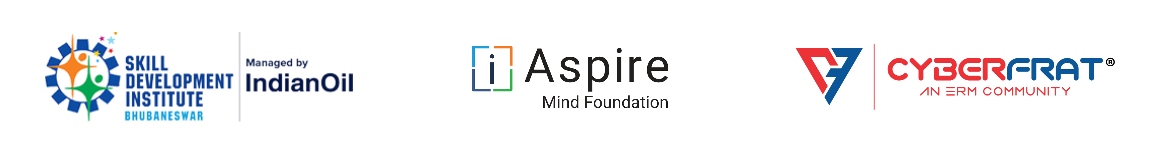
Windows & Linux Security

Slide 37
Operating System Security
Possible for a system to be compromised during the installation process before it can install the latest patches
Building and deploying a system should be a planned process designed to counter this threat
Process must:
assess risks and plan the system deployment
secure the underlying operating system and then the key applications
ensure any critical content is secured
ensure appropriate network protection mechanisms are used
ensure appropriate processes are used to maintain security
Notes:
As we noted above, computer client and server systems are central components
of the IT infrastructure for most organizations, may hold critical data and
applications, and are a necessary tool for the function of an organization.
Accordingly, we need to be aware of the expected presence of vulnerabilities
in operating systems and applications as distributed, and the existence of
worms scanning for such vulnerabilities at high rates, such as we discussed in
Section 6.3 . Thus, it is quite possible for a system to be compromised during
the installation process before it can install the latest patches or implement
other hardening measures. Hence building and deploying a system should be
a planned process designed to counter such a threat, and to maintain security
during its operational lifetime.
[NIST08] states that this process must:
• assess risks and plan the system deployment
• secure the underlying operating system and then the key applications
• ensure any critical content is secured
• ensure appropriate network protection mechanisms are used
• ensure appropriate processes are used to maintain security
While we address the selection of network protection mechanisms in Chapter 9 , we
examine the other items in the rest of this chapter.

Slide 38
System Security Planning
The first step in deploying a new system is planning
Plan needs to identify appropriate personnel and training to install and manage the system
Planning process needs to determine security requirements for the system, applications, data, and users
Aim: maximize security while minimizing costs

Slide 39
System Security Planning Process
The purpose of the system, the type of information stored, the applications and services provided, and their security requirements
The categories of users of the system, the privileges they have, and the types of information they can access
How the users are authenticated
Who will administer the system
What access the system has to information stored on other hosts, such as file or database servers, and how this is managed
Who will administer the system, and how they will manage the system (via local or remote access)
Additional security (firewalls, anti-virus or other malware protection mechanisms, and logging, …)
Notes:
[NIST08] provides a list of items that should be considered during the system
security planning process. While its focus is on secure server deployment, much of
the list applies equally well to client system design. This list includes consideration of:
• the purpose of the system, the type of information stored, the applications and
services provided, and their security requirements
• the categories of users of the system, the privileges they have, and the types of
information they can access
• how the users are authenticated
• how access to the information stored on the system is managed
• what access the system has to information stored on other hosts, such as file or
database servers, and how this is managed
• who will administer the system, and how they will manage the system (via
local or remote access)
• any additional security measures required on the system, including the use of
host firewalls, anti-virus or other malware protection mechanisms, and logging

Slide 40
Operating Systems Hardening
First critical step in securing a system is to secure the base operating system
Basic steps
Install and patch the operating system
Harden and configure the operating system to adequately address the identified security needs of the system
Install and configure additional security controls, such as anti-virus, host-based firewalls, and intrusion detection system (IDS)
Test the security of the basic operating system to ensure that the steps taken adequately address its security needs
Notes:
The first critical step in securing a system is to secure the base operating system upon
which all other applications and services rely. A good security foundation needs a
properly installed, patched, and configured operating system. Unfortunately, the
default configuration for many operating systems often maximizes ease of use and
functionality, rather than security. Further, since every organization has its own
security needs, the appropriate security profile, and hence configuration, will also
differ. What is required for a particular system should be identified during the
planning phase, as we have just discussed.
While the details of how to secure each specific operating system differ, the
broad approach is similar. Appropriate security configuration guides and checklists
exist for most common operating systems, and these should be consulted, though
always informed by the specific needs of each organization and their systems. In
some cases, automated tools may be available to further assist in securing the system
configuration.
[NIST08] suggests the following basic steps should be used to secure an operating
system:
• install and patch the operating system
• harden and configure the operating system to adequately address the identified
security needs of the system by:
• removing unnecessary services, applications, and protocols
• configuring users, groups, and permissions
• configuring resource controls
• install and configure additional security controls, such as anti-virus, host-based
firewalls, and intrusion detection systems (IDS), if needed
• test the security of the basic operating system to ensure that the steps taken
adequately address its security needs

Slide 41
Initial Setup and Patching
System security begins with the installation of the operating system
Ideally new systems should be constructed on a protected network
Full installation and hardening process should occur before the system is deployed to its intended location
Initial installation should install the minimum necessary for the desired system
Overall boot process must also be secured
The integrity and source of any additional device driver code must be carefully validated
it is critical that the system be kept up to date, with all critical security related patches installed
Should stage and validate all patches on the test systems before deploying them in production
Notes:
System security begins with the installation of the operating system. As we have
already noted, a network connected, unpatched system, is vulnerable to exploit during
its installation or continued use. Hence it is important that the system not be
exposed while in this vulnerable state. Ideally new systems should be constructed on
a protected network. This may be a completely isolated network, with the operating
system image and all available patches transferred to it using removable media such
as DVDs or USB drives. Given the existence of malware that can propagate using
removable media, as we discuss in Chapter 6 , care is needed to ensure the media
used here is not so infected. Alternatively, a network with severely restricted access
to the wider Internet may be used. Ideally it should have no inbound access, and
have outbound access only to the key sites needed for the system installation and
patching process. In either case, the full installation and hardening process should
occur before the system is deployed to its intended, more accessible, and hence vulnerable,
location.
The initial installation should install the minimum necessary for the desired
system, with additional software packages included only if they are required for
the function of the system. We explore the rationale for minimizing the number of
packages on the system shortly.
The overall boot process must also be secured. This may require adjusting
options on, or specifying a password required for changes to, the BIOS code used
when the system initially boots. It may also require limiting which media the system
is normally permitted to boot from. This is necessary to prevent an attacker
from changing the boot process to install a covert hypervisor, such as we discussed
in Section 6.8 , or to just boot a system of their choice from external media
in order to bypass the normal system access controls on locally stored data. The
use of a cryptographic file system may also be used to address this threat, as we
note later.
Care is also required with the selection and installation of any additional
device driver code, since this executes with full kernel level privileges, but is often
supplied by a third party. The integrity and source of such driver code must be carefully
validated given the high level of trust it has. A malicious driver can potentially
bypass many security controls to install malware. This was done in both the
Blue Pill demonstration rootkit, which we discussed in Section 6.8 , and the Stuxnet
worm, which we described in Section 6.3 .
Given the continuing discovery of software and other vulnerabilities for commonly
used operating systems and applications, it is critical that the system be kept
as up to date as possible, with all critical security related patches installed. Indeed,
doing this addresses the top two of the four key DSD mitigation strategies we listed
previously. Nearly all commonly used systems now provide utilities that can automatically
download and install security updates. These tools should be configured
and used to minimize the time any system is vulnerable to weaknesses for which
patches are available.
Note that on change-controlled systems, you should not run automatic
updates, because security patches can, on rare but significant occasions, introduce
instability. For systems on which availability and uptime are of paramount importance,
therefore, you should stage and validate all patches on test systems before
deploying them in production.

Slide 42
Remove Unnecessary Services
if fewer software packages are available to run the risk is reduced
system planning process should identify what is actually required for a given system
when performing the initial installation the supplied defaults should not be used
default configuration is set to maximize ease of use and functionality rather than security
if additional packages are needed later they can be installed when they are required
Notes:
Because any of the software packages running on a system may contain software
vulnerabilities, clearly if fewer software packages are available to run, then the risk
is reduced. There is clearly a balance between usability, providing all software that
may be required at some time, with security and a desire to limit the amount of
software installed. The range of services, applications, and protocols required will
vary widely between organizations, and indeed between systems within an organization.
The system planning process should identify what is actually required for a
given system, so that a suitable level of functionality is provided, while eliminating
software that is not required to improve security.
The default configuration for most distributed systems is set to maximize ease
of use and functionality, rather than security. When performing the initial installation,
the supplied defaults should not be used, but rather the installation should be
customized so that only the required packages are installed. If additional packages
are needed later, they can be installed when they required. [NIST08] and many of
the security hardening guides provide lists of services, applications, and protocols
that should not be installed if not required.
[NIST08] also states a strong preference for not installing unwanted software,
rather than installing and then later removing or disabling it. It argues this preference
because they note that many uninstall scripts fail to completely remove all
components of a package. They also note that disabling a service means that while
it is not available as an initial point of attack, should an attacker succeed in gaining
some access to a system, then disabled software could be re-enabled and used to
further compromise a system. It is better for security if unwanted software is not
installed, and thus not available for use at all.

Slide 43
Configure Users and Privileges
Not all users with access to a system will have the same access to all data and resources on that system
Elevated privileges should be restricted to only those users that require them, and then only when they are needed to perform a task
System planning process should consider:
categories of users on the system
privileges they have
types of information they can access
Default accounts included as part of the system installation should be secured
those that are not required should be either removed or disabled
policies that apply to authentication credentials configured
Notes:
Not all users with access to a system will have the same access to all data and
resources on that system. All modern operating systems implement access controls
to data and resources, as we discuss in Chapter 4 . Nearly all provide some form of
discretionary access controls. Some systems may provide role-based or mandatory
access control mechanisms as well.
The system planning process should consider the categories of users on
the system, the privileges they have, the types of information they can access,
and how and where they are defined and authenticated. Some users will have
elevated privileges to administer the system; others will be normal users, sharing
appropriate access to files and other data as required; and there may even be
guest accounts with very limited access. The third of the four key DSD mitigation
strategies is to restrict elevated privileges to only those users that require them.
Further, it is highly desirable that such users only access elevated privileges when
needed to perform some task that requires them, and to otherwise access the
system as a normal user. This improves security by providing a smaller window
of opportunity for an attacker to exploit the actions of such privileged users.
Some operating systems provide special tools or access mechanisms to assist
administrative users to elevate their privileges only when necessary, and to
appropriately log these actions.
One key decision is whether the users, the groups they belong to, and their
authentication methods are specified locally on the system or will use a centralized
authentication server. Whichever is chosen, the appropriate details are now
configured on the system.
Also at this stage, any default accounts included as part of the system installation
should be secured. Those which are not required should be either removed
or at least disabled. System accounts that manage services on the system should
be set so they cannot be used for interactive logins. And any passwords installed
by default should be changed to new values with appropriate security.
Any policy that applies to authentication credentials, and especially to
password security, is also configured. This includes details of which authentication
methods are accepted for different methods of account access. And it includes
details of the required length, complexity, and age allowed for passwords. We
discuss some of these issues in Chapter 3 .

Slide 44
Configure Resource Controls
Once the users and groups are defined, appropriate permissions can be set on data and resources
Many of the security hardening guides provide lists of recommended changes to the default access configuration
Further security possible by installing and configuring additional security tools:
Anti-virus software
Host-based firewalls
IDS or IPS software
Application white-listing

Slide 45
System Testing
Final step in the process of initially securing the base operating system is security testing
Goal: Ensure the previous security configuration steps are correctly implemented
Checklists are included in security hardening guides
There are programs specifically designed to:
Review a system to ensure that a system meets the basic security requirements
Scan for known vulnerabilities and poor configuration practices

Slide 46
Application Configuration
May include:
Creating and specifying appropriate data storage areas for application
Making appropriate changes to the application or service default configuration details
Some applications or services may include:
Default data, scripts, user accounts
Of particular concern with remotely accessed services such as Web and file transfer services
Risk from this form of attack is reduced by ensuring that most of the files can only be read, but not written, by the server
Notes:
Any application specific configuration is then performed. This may include creating
and specifying appropriate data storage areas for the application, and making
appropriate changes to the application or service default configuration details.
Some applications or services may include default data, scripts, or user
accounts. These should be reviewed, and only retained if required, and suitably
secured. A well-known example of this is found with Web servers, which often
include a number of example scripts, quite a few of which are known to be insecure.
These should not be used as supplied.
As part of the configuration process, careful consideration should be given to
the access rights granted to the application. Again, this is of particular concern with
remotely accessed services, such as Web and file transfer services. The server application
should not be granted the right to modify files, unless that function is specifically
required. A very common configuration fault seen with Web and file transfer
servers is for all the files supplied by the service to be owned by the same “user”
account that the server executes as. The consequence is that any attacker able to
exploit some vulnerability in either the server software or a script executed by the
server may be able to modify any of these files. The large number of “Web defacement”
attacks is clear evidence of this type of insecure configuration. Much of the
risk from this form of attack is reduced by ensuring that most of the files can only
be read, but not written, by the server. Only those files that need to be modified, to
store uploaded form data for example, or logging details, should be writeable by the
server. Instead the files should mostly be owned and modified by the users on the
system who are responsible for maintaining the information.

Slide 47
Encryption Technology
A key enabling technology that may be used to secure data both in transit and when stored
Must be configured and appropriate cryptographic keys created, signed, and secured
If secure network services are provided using TLS or IPsec suitable public and private keys must be generated for each of them
If secure network services are provided using SSH, appropriate server and client keys must be created
Cryptographic file systems are another use of encryption
Notes:
Encryption is a key enabling technology that may be used to secure data both in
transit and when stored, as we discuss in Chapter 2 and in Parts Four and Five.
If such technologies are required for the system, then they must be configured, and
appropriate cryptographic keys created, signed, and secured.
If secure network services are provided, most likely using either TLS or IPsec,
then suitable public and private keys must be generated for each of them. Then
X.509 certificates are created and signed by a suitable certificate authority, linking
each service identity with the public key in use, as we discuss in Section 23.2 . If
secure remote access is provided using Secure Shell (SSH), then appropriate server,
and possibly client keys, must be created.
Cryptographic file systems are another use of encryption. If desired, then
these must be created and secured with suitable keys.

Slide 48
Security Maintenance
Process of maintaining security is continuous
Security maintenance includes:
Monitoring and analyzing logging information
Performing regular backups
Recovering from security compromises
Regularly testing system security
Using appropriate software maintenance processes to patch and update all critical software, and to monitor and revise configuration as needed
Notes:
Once the system is appropriately built, secured, and deployed, the process of maintaining
security is continuous. This results from the constantly changing environment,
the discovery of new vulnerabilities, and hence exposure to new threats.
[NIST08] suggests that this process of security maintenance includes the following
additional steps:
• monitoring and analyzing logging information
• performing regular backups
• recovering from security compromises
• regularly testing system security
• using appropriate software maintenance processes to patch and update all
critical software, and to monitor and revise configuration as needed
We have already noted the need to configure automatic patching and update where
possible, or to have a process to manually test and install patches on configuration
controlled systems, and that the system should be regularly tested using checklist
or automated tools where possible. We discuss the process of incident response in
Section 15.5 . We now consider the critical logging and backup procedures.

Slide 49
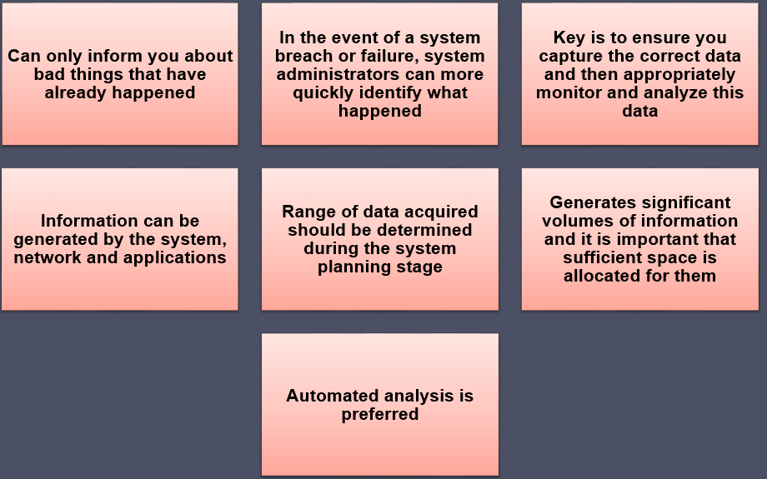
Logging

Slide 50
Data Backup and Archive
Performing regular backups of data is a critical control that assists with maintaining the integrity of the system and user data
Backup
Archive
Needs and policy relating to backup and archive should be determined during the system planning stage
The process of retaining copies of data over extended periods of time in order to meet legal and operational requirements to access past data
Kept online or offline
Stored locally or transported to a remote site
Trade-offs include ease of implementation and cost versus greater security and robustness against different threats

Slide 51
LINUX SECURITY

Slide 52
What is Linux ?
Linux is a free open source operating system (OS) based on UNIX that was created in 1991 by Linus Torvalds. Users can modify and create variations of the source code, known as distributions, for computers and other devices. The most common use is as a server, but Linux is also used in desktop computers, smartphones, e-book readers and gaming consoles etc.
It is also used by Hackers
Linux Types :
Ubuntu
Redhat
Suse
Debian
Centos
Oracle

Slide 53
Hardening
Hardening refers to providing various means of protection in a computer system. Protection is provided in various layers and is often referred to as defense in depth. Protecting in layers means to protect at the host level, the application level, the operating system level, the user level, the physical level and all the sublevels in between. Each level requires a unique method of security.
A hardened computer system is a more secure computer system.
Hardening is also known as system hardening.
Guides :
Guides : CIS Benchmark
Tools : Scap , Lynis

Slide 54
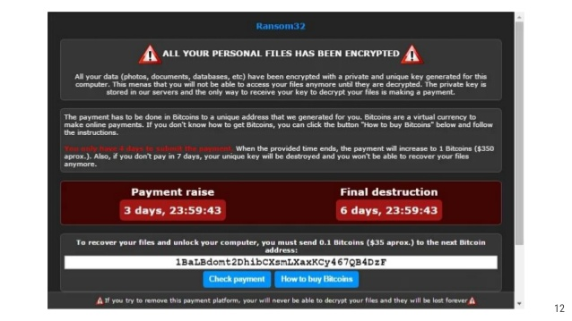
What if we don’t Hardening ?

Slide 55
Users and Groups
Users and Groups are used to control access to files and resources . Different permissions are also applied depending on users and groups.
Users:
Every user of the system is assigned a unique user id known as UID.
Users names and UID’S are stored in this location -/etc/passwd. Users can’t read ,write or executable each other’s file without permissions.
Groups:
Users are assigned to groups with unique group id numbers known as the gid.
Each user is given their own group . gids are stored in this location -/etc/group.

Slide 56
File Security
File Permissions:
Every file and directory in your UNIX/Linux system has following 3 permissions defined for all the 3 owners discussed above.
Read (r): This permission give you the authority to open and read a file. Read permission on a directory gives you the ability to lists its content.
Write (w): The write permission gives you the authority to modify the contents of a file. The write permission on a directory gives you the authority to add, remove and rename files stored in the directory. Consider a scenario where you have to write permission on file but do not have write permission on the directory where the file is stored. You will be able to modify the file contents. But you will not be able to rename, move or remove the file from the directory.

Slide 57
Execute (x): In Windows, an executable program usually has an extension ".exe" and which you can easily run. In Unix/Linux, you cannot run a program unless the execute permission is set. If the execute permission is not set, you might still be able to see/modify the program code(provided read & write permissions are set), but not run it.
Special Permissions:
In this we have four cases. They are :
SUID (Set – user Identification) for an execution.
SGID (set group ID) for an execution.
SGID (set group ID) for an Directory.
Sticky bit for a directory
LINK: https://thegeeksalive.com/linux-special-permissions/
INODES :
An inode is a data structure on a traditional Unix-style file system such as UFS or ext3. An inode stores basic information about a regular file, directory, or other file system object.
https://www.cyberciti.biz/tips/understanding-unixlinux-filesystem-inodes.html

Slide 58
Linux Server Hardening
Steps :
Boot Security
Patching Linux Kernel
Remove Unused Software
Strong Password Policy
Securing Root Login
Process Security

Slide 59
1.Boot Security :
Boot loader is useful in preventing unauthorized users who have physical access to systems from booting using removable media like USB .
LILO and GRUB are two boot security loaders for linux workstations.
GRUB | LILO
GRUB stands for Grand Unified Boot Loader | LILO stands for Linux Loader
It support for unlimited boot entries | LILO only support up to 16 different boot selection
GRUB boot from network | LILO does not boot from network
There is no need to change GRUB if configure file changed . GRUB is dynamically configure | There is need to change LILO if configure file changed . LILO is not dynamically configure
GRUB has interactive command interface | LILO does not have interactive command interface
GRUB has knowledge of file system | LILO does not have any knowledge of file system

Slide 60
LILO Configure File :
Boot =/dev/had
Map =/boot/map
Install =/boot/boot.b
Prompt
Timeout = 100
Compact
Default = Linux
Image = /boot/vmlinuz-2.4.18-14
Label =Linux
Root = /dev/hdb3
Read-only
Password=linux
Other=/dev/had
Label=windowsXP

Slide 61
GRUB Configure File :
Default=0
Timeout=10
Splashimage=(hd1,2)/grub/splash.xp.gz
Password –md5 $1$0pevt0$y.br.18LYAasRsGdSKLY1p1
Title Red Hat Linux
Password –md5 $1$0pevt0$y.br.18LYAasRsGdSKLY1p1
Root (hd1,2)
Kernal /vmlinuz-2.4.18-14 ro root == LABEL =/initrd /initrd-2.4.18-14.img
Savedefault
boot

Slide 62
2.Patching Linux Kernel:
What is a patch?
A patch is a small text document containing a delta of changes between two different versions of a source tree. Patches are created with the diff program.
To correctly apply a patch you need to know what base it was generated from and what new version the patch will change the source tree into. These should both be present in the patch file metadata or be possible to deduce from the filename.
Patching Linux includes :
Getting new kernel modules
Editing LILO.conf
Restarting LILO
Write new MBR
Kpatch – Dynamic Kernel Patching :
Kpatch is a feature of the linux kernel that allows live patching of a running kernel which allows kernel
Patches to be applied to the kernel for security even through the kernel is still running

Slide 63
3.Remove Unused Software:
Commands:
For Red Hat/ RHEL/ Fedora / Centos :
$ yum list installed
$ yum list packageName
$ yum remove PackageName
Debian/Ubuntu Linux :
$ dpkg –l
$ dpkg --info packageName
$ apt-get remove packageName

Slide 64
4.Strong Password Policy :
Configuration of shadow password:
Command:
Nano /etc/login.defs
Configuration Parameters:
PASS_MAX_DAYS=30
PASS_WARN_AGE=20
ENCRYPT_METHOD SHA512
LOGIN_RETRIES =5
Password Files in Linux:
/etc/Passwd | /etc/shadow
It has one way encrypted passwords are stored in a text file. | Shadow utils is a package in linux that’s installed by default in most of the distributions.
This file is readable by any user in the system. | This directory is only accessible to root.

Slide 65
5.Process Security :
It is a mix of administrative, engineering and behavioral activities focused on preventing undesired accidents and unexpected events that may have a negative impact to a given process.
We have some components:
Exec thread
PID
Memory Context
Environment
Priority
Security Credentials
File descriptor

Slide 66
6.Securing Root Login:
Disabling Root access via any console device (tty).
edit the securetty file vim/etc/securetty and comment out the following lines:
tty1
#tty2
It means root is allowed to login at tty1. tty2 is disabled.

Slide 67
Operating System
Patching and Software Updates: periodically patches are released for included software either due to security flaws or to include additional functionality.
File System Configuration:
Create Separate Partition for /tmp: grep “[[:Space:]]/tmp[[:space:]]” /etc/fstab
Create Separate Partition for /var: grep “[[:Space:]]/var[[:space:]]” /etc/fstab
Secure Boot Settings :
Set permissions on boot loader config: chmod og-rwx/boot/grub/grub.cfg
Set Boot Loader Password : grub-mkpasswd-pbkdf2
Os Services:
Ensure rsh server is not enabled
Ensure telnet server is not enabled

Slide 68
SELinux
Security-Enhanced Linux (SELinux) is a security architecture for Linux systems that allows administrators to have more control over who can access the system. It was originally developed by the United States National Security Agency (NSA) as a series of patches to the Linux kernel using Linux Security Modules (LSM). In SELinux has MAC and DAC
SELinux Configuration files :
Getenforce
Sestatus
Setenforce
DAC | MAC
User has complete control overall programs it owns and execute. | Administrators manages the access controls unlike the users in DAC
Administrators have no way to control users. | Administrators define the access policy

Slide 69
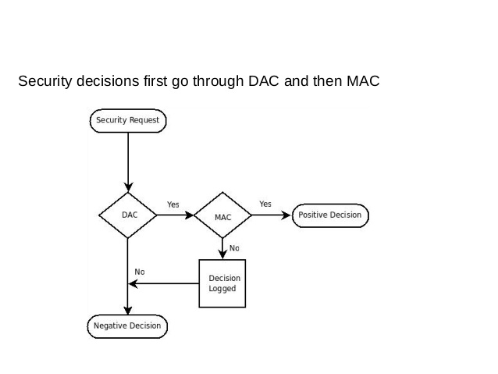

Slide 70
Linux/Unix Security: Patch/Configs
Patch management
keeping security patches up to date is a widely recognized and critical control for maintaining security
application and service configuration
most commonly implemented using separate text files for each application and service
generally located either in the /etc directory or in the installation tree for a specific application
individual user configurations that can override the system defaults are located in hidden “dot” files in each user’s home directory
most important changes needed to improve system security are to disable services and applications that are not required
Notes:
Ensuring that system and application code is kept up to date with security patches is
a widely recognized and critical control for maintaining security.
Modern Unix and Linux distributions typically include tools for automatically
downloading and installing software updates, including security updates, which
can minimize the time a system is vulnerable to known vulnerabilities for which
patches exist. For example, Red Hat, Fedora, and CentOS include up2date or
yum ; SuSE includes yast; and Debian uses apt-get , though you must run it as
a cron job for automatic updates. It is important to configure whichever update tool
is provided on the distribution in use, to install at least critical security patches in a
timely manner.
As noted earlier, change-controlled systems should not run automatic updates,
because they may possibly introduce instability. Such systems should validate all
patches on test systems before deploying them to production systems.
Configuration of applications and services on Unix and Linux systems is most
commonly implemented using separate text files for each application and service.
System-wide configuration details are generally located either in the /etc directory
or in the installation tree for a specific application. Where appropriate, individual
user configurations that can override the system defaults are located in hidden
“dot” files in each user’s home directory. The name, format, and usage of these files
are very much dependent on the particular system version and applications in use.
Hence the systems administrators responsible for the secure configuration of such a
system must be suitably trained and familiar with them.
Traditionally, these files were individually edited using a text editor, with
any changes made taking effect either when the system was next rebooted or when
the relevant process was sent a signal indicating that it should reload its configuration
settings. Current systems often provide a GUI interface to these configuration
files to ease management for novice administrators. Using such a manager may be
appropriate for small sites with a limited number of systems. Organizations with
larger numbers of systems may instead employ some form of centralized management,
with a central repository of critical configuration files that can be automatically
customized and distributed to the systems they manage.
The most important changes needed to improve system security are to disable
services, especially remotely accessible services, and applications, that are not
required, and to then ensure that applications and services that are needed are
appropriately configured, following the relevant security guidance for each. We
provide further details on this in Section 25.5 .

Slide 71
Linux/Unix Security
Users, groups, and permissions
access is specified as granting read, write, and execute permissions to each of owner, group, and others for each resource
guides recommend changing the access permissions for critical directories and files
local exploit
software vulnerability that can be exploited by an attacker to gain elevated privileges
remote exploit
software vulnerability in a network server that could be triggered by a remote attacker
Notes:
As we describe in Sections 4.5 and 25.3 , Unix and Linux systems implement discretionary
access control to all file system resources. These include not only files
and directories but devices, processes, memory, and indeed most system resources.
Access is specified as granting read, write, and execute permissions to each of
owner, group, and others, for each resource, as shown in Figure 4.6 . These are set
using the chmod command. Some systems also support extended file attributes with
access control lists that provide more flexibility, by specifying these permissions for
each entry in a list of users and groups. These extended access rights are typically set
and displayed using the getfacl and setfacl commands. These commands can
also be used to specify set user or set group permissions on the resource.
Information on user accounts and group membership are traditionally stored
in the /etc/passwd and /etc/group files, though modern systems also have the
ability to import these details from external repositories queried using LDAP or NIS
for example. These sources of information, and indeed of any associated authentication
credentials, are specified in the PAM (pluggable authentication module)
configuration for the system, often using text files in the /etc/pam.d directory.
In order to partition access to information and resources on the system, users
need to be assigned to appropriate groups granting them any required access. The
number and assignments to groups should be decided during the system security
planning process, and then configured in the appropriate information repository,
whether locally using the configuration files in /etc, or on some centralized database.
At this time, any default or generic users supplied with the system should be
checked, and removed if not required. Other accounts that are required, but are not
associated with a user that needs to login, should have login capability disabled, and
any associated password or authentication credential removed.
Guides to hardening Unix and Linux systems also often recommend changing
the access permissions for critical directories and files, in order to further limit
access to them. Programs that set user (setuid) to root or set group (setgid) to a privileged
group are key target for attackers. As we detail in Sections 4.5 and 25.3 , such
programs execute with superuser rights, or with access to resources belonging to the
privileged group, no matter which user executes them. A software vulnerability in
such a program can potentially be exploited by an attacker to gain these elevated
privileges. This is known as a local exploit. A software vulnerability in a network
server could be triggered by a remote attacker. This is known as a remote exploit.
It is widely accepted that the number and size of setuid root programs in particular
should be minimized. They cannot be eliminated, as superuser privileges are
required to access some resources on the system. The programs that manage user
login, and allow network services to bind to privileged ports, are examples. However,
other programs, that were once setuid root for programmer convenience, can function
as well if made setgid to a suitable privileged group that has the necessary access to
some resource. Programs to display system state, or deliver mail, have been modified
in this way. System hardening guides may recommend further changes and indeed the
removal of some such programs that are not required on a particular system.

Slide 72
Linux/Unix Security
Chroot jail
restricts the server’s view of the file system to just a specified portion
uses chroot system call to confine a process by mapping the root of the filesystem to some other directory
file directories outside the chroot jail aren’t visible or reachable
main disadvantage is added complexity
Notes:
Some network accessible services do not require access to the full file-system, but
rather only need a limited set of data files and directories for their operation. FTP is
a common example of such a service. It provides the ability to download files from,
and upload files to, a specified directory tree. If such a server were compromised and
had access to the entire system, an attacker could potentially access and compromise
data elsewhere. Unix and Linux systems provide a mechanism to run such services in a
chroot jail , which restricts the server’s view of the file system to just a specified portion.
This is done using the chroot system call that confines a process to some subset of the file
system by mapping the root of the filesystem “/” to some other directory (e.g., /srv/
ftp/public). To the “chrooted” server, everything in this chroot jail appears to
actually be in / (e.g., the “real” directory /srv/ftp/public/etc/myconfigfile
appears as /etc/myconfigfile in the chroot jail). Files in directories outside the
chroot jail (e.g., /srv/www or /etc.) aren’t visible or reachable at all.
Chrooting therefore helps contain the effects of a given server being compromised
or hijacked. The main disadvantage of this method is added complexity: a
number of files (including all executable libraries used by the server), directories,
and devices needed must be copied into the chroot jail. Determining just what needs
to go into the jail for the server to work properly can be tricky, though detailed procedures
for chrooting many different applications are available.
Troubleshooting a chrooted application can also be difficult. Even if an application
explicitly supports this feature, it may behave in unexpected ways when run
chrooted. Note also that if the chrooted process runs as root, it can “break out” of
the chroot jail with little difficulty. Still, the advantages usually far outweigh the
disadvantages of chrooting network services.
The system hardening guides such as those provided by the “NSA—Security
Configuration Guides” include security checklists for a number of Unix and Linux
distributions that may be followed.
There are also a number of commercial and open-source tools available to perform
system security scanning and vulnerability testing. One of the best known is
“Nessus.” This was originally an open-source tool, which was commercialized in 2005,
though some limited free-use versions are available. “Tripwire” is a well-known file
integrity checking tool that maintains a database of cryptographic hashes of monitored
files, and scans to detect any changes, whether as a result of malicious attack, or simply
accidental or incorrectly managed update. This again was originally an open-source
tool, which now has both commercial and free variants available. The “Nmap” network
scanner is another well-known and deployed assessment tool that focuses on identifying
and profiling hosts on the target network, and the network services they offer.

Slide 73
Windows Security
Patch management
“Windows Update” and “Windows Server Update Service” assist with regular maintenance and should be used
third party applications also provide automatic update support
Users administration and access controls
systems implement discretionary access controls resources
Vista and later systems include mandatory integrity controls
objects are labeled as being of low, medium, high, or system integrity level
system ensures the subject’s integrity is equal or higher than the object’s level
implements a form of the Biba Integrity model
Notes:
We now consider some specific issues with the secure installation, configuration,
and management of Microsoft Windows systems. These systems have for many
years formed a significant portion of all “general purpose” system installations.
Hence, they have been specifically targeted by attackers, and consequently security
countermeasures are needed to deal with these challenges. The process of providing
appropriate levels of security still follows the general outline we describe in this
chapter. Beyond the general guidance in this section, we provide more detailed discussion
of Windows security mechanisms later in Chapter 26 .
Again, there are a large range of resources available to assist administrators
of these systems, including reports such as [SYMA07], online resources such as the
“Microsoft Security Tools & Checklists,” and specific system hardening guides such
as those provided by the “NSA—Security Configuration Guides.”
The “Windows Update” service and the “Windows Server Update Services” assist
with the regular maintenance of Microsoft software, and should be configured and
used. Many other third-party applications also provide automatic update support,
and these should be enabled for selected applications.
Users and groups in Windows systems are defined with a Security ID (SID). This
information may be stored and used locally, on a single system, in the Security
Account Manager (SAM). It may also be centrally managed for a group of systems
belonging to a domain, with the information supplied by a central Active Directory
(AD) system using the LDAP protocol. Most organizations with multiple systems
will manage them using domains. These systems can also enforce common policy
on users on any system in the domain. We further explore the Windows security
architecture in Section 26.1 .
Windows systems implement discretionary access controls to system resources
such as files, shared memory, and named pipes. The access control list has a number of
entries that may grant or deny access rights to a specific SID, which may be for an individual
user or for some group of users. Windows Vista and later systems also include
mandatory integrity controls. These label all objects, such as processes and files, and
all users, as being of low, medium, high, or system integrity level. Then whenever data
is written to an object, the system first ensures that the subject’s integrity is equal or
higher than the object’s level. This implements a form of the Biba Integrity model
we discuss in Section 13.2 that specifically targets the issue of untrusted remote code
executing in, for example Windows Internet Explorer, trying to modify local resources.

Slide 74
Windows Security
Much of the configuration information is centralized in the Registry
Forms a database of keys and values that may be queried and interpreted by applications
Registry keys can be directly modified using the “Registry Editor”
more useful for making bulk changes
Notes:
Unlike Unix and Linux systems, much of the configuration information in Windows
systems is centralized in the Registry, which forms a database of keys and values
that may be queried and interpreted by applications on these systems.
Changes to these values can be made within specific applications, setting preferences
in the application that are then saved in the registry using the appropriate keys
and values. This approach hides the detailed representation from the administrator.
Alternatively, the registry keys can be directly modified using the “Registry Editor.”
This approach is more useful for making bulk changes, such as those recommended
in hardening guides. These changes may also be recorded in a central repository, and
pushed out whenever a user logs in to a system within a network domain.
Given the predominance of malware that targets Windows systems, it is essential
that suitable anti-virus, anti-spyware, personal firewall, and other malware and
attack detection and handling software packages are installed and configured on
such systems. This is clearly needed for network connected systems, as shown by
the high-incidence numbers in reports such as [SYMA11]. However, as the Stuxnet
attacks in 2010 show, even isolated systems updated using removable media are
vulnerable, and thus must also be protected.

Slide 75
Windows Security
Other security controls
Essential that anti-virus, anti-spyware, personal firewall, and other malware and attack detection and handling software packages are installed and configured
Current generation Windows systems include basic firewall and malware countermeasure capabilities
Important to ensure the set of products in use are compatible
Windows systems also support a range of cryptographic functions:
Encrypting files and directories using the Encrypting File System (EFS)
Full-disk encryption with AES using BitLocker
“Microsoft Baseline Security Analyzer”
Free, easy to use tool that checks for compliance with Microsoft’s security recommendations
Notes:
Current generation Windows systems include some basic firewall and malware
countermeasure capabilities, which should certainly be used at a minimum.
However, many organizations find that these should be augmented with one or
more of the many commercial products available. One issue of concern is undesirable
interactions between anti-virus and other products from multiple vendors. Care
is needed when planning and installing such products to identify possible adverse
interactions, and to ensure the set of products in use are compatible with each other.
Windows systems also support a range of cryptographic functions that may
be used where desirable. These include support for encrypting files and directories
using the Encrypting File System (EFS), and for full-disk encryption with AES
using BitLocker.
The system hardening guides such as those provided by the “NSA—Security
Configuration Guides” also include security checklists for various versions of
Windows.
There are also a number of commercial and open-source tools available to
perform system security scanning and vulnerability testing of Windows systems. The
“Microsoft Baseline Security Analyzer” is a simple, free, easy-to-use tool that aims
to help small- to medium-sized businesses improve the security of their systems by
checking for compliance with Microsoft’s security recommendations. Larger organizations
are likely better served using one of the larger, centralized, commercial
security analysis suites available.

Slide 76
Virtualization
A technology that provides an abstraction of the resources used by some software which runs in a simulated environment called a virtual machine (VM)
Benefits include better efficiency in the use of the physical system resources
Provides support for multiple distinct operating systems and associated applications on one physical system
Raises additional security concerns
Notes:
Virtualization refers to a technology that provides an abstraction of the computing
resources used by some software, which thus runs in a simulated environment
called a virtual machine (VM). There are many types of virtualization; however, in
this section we are most interested in full virtualization. This allows multiple full
operating system instances to execute on virtual hardware, supported by a hypervisor
that manages access to the actual physical hardware resources. Benefits arising
from using virtualization include better efficiency in the use of the physical system
resources than is typically seen using a single operating system instance. This is particularly
evident in the provision of virtualized server systems. Virtualization can
also provide support for multiple distinct operating systems and associated applications
on the one physical system. This is more commonly seen on client systems.
There are a number of additional security concerns raised in virtualized systems,
as a consequence both of the multiple operating systems executing side by side
and of the presence of the virtualized environment and hypervisor as a layer below
the operating system kernels and the security services they provide. [CLEE09]
presents a survey of some of the security issues arising from such a use of virtualization,
a number of which we will discuss further.

Slide 77
Virtualization Alternatives
Application virtualization (e.g., JVM)
allows applications written for one environment to execute on some other operating system
full virtualization (e.g., multiple guest OS)
multiple full operating system instances execute in parallel
virtual machine monitor (VMM) coordinates RAM, processor, … uses
hypervisor
coordinates access between each of the guests and the actual physical hardware resources
Notes:
There are many forms of creating a simulated, virtualized environment. These
include application virtualization , as provided by the Java Virtual Machine environment.
This allows applications written for one environment, to execute on some
other operating system. It also includes full virtualization , in which multiple full
operating system instances execute in parallel. Each of these guest operating systems,
along with their own set of applications, executes in its own VM on virtual
hardware. These guest OSs are managed by a hypervisor , or virtual machine monitor
(VMM), that coordinates access between each of the guests and the actual physical
hardware resources, such as CPU, memory, disk, network, and other attached
devices. The hypervisor provides a similar hardware interface as that seen by operating
systems directly executing on the actual hardware. As a consequence, little if
any modification is needed to the guest OSs and their applications. Recent generations
of CPUs provide special instructions that improve the efficiency of hypervisor
operation.

Slide 78
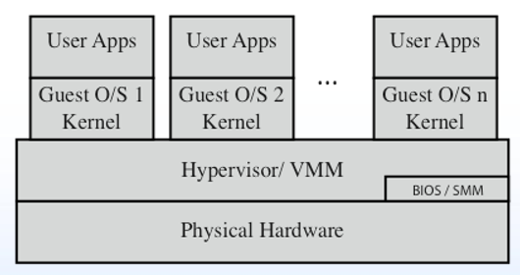
Full Virtualization Variations
Native virtualization: the hypervisor executes directly on the underlying hardware
Hosted OS is just another app
More secure: fewer layers

Slide 79
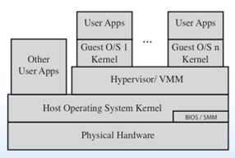
Full Virtualization Variations
Hosted virtualization: Hosted OS run along other apps
Adds additional layers: increased security concerns

Slide 80
Virtualization Security Issues
Security concerns include:
Guest OS isolation: ensuring that programs executing within a guest OS may only access and use the resources allocated to it
Guest OS monitoring by the hypervisor: has privileged access to the programs and data in each guest OS and must be trust
Virtualized environment security: particularly image and snapshot management which attackers may attempt to view or modify
Notes:
[CLEF09] and [NIST11] both detail a number of security concerns that result from
the use of virtualized systems, including:
• guest OS isolation, ensuring that programs executing within a guest OS may
only access and use the resources allocated to it, and not covertly interact with
programs or data either in other guest OSs or in the hypervisor.
• guest OS monitoring by the hypervisor, which has privileged access to the
programs and data in each guest OS, and must be trusted as secure from
subversion and compromised use of this access
virtualized environment security, particularly as regards image and snapshot
management, which attackers may attempt to view or modify
These security concerns may be regarded as an extension of the concerns we have
already discussed with securing operating systems and applications. If a particular
operating system and application configuration is vulnerable when running directly
on hardware in some context, it will most likely also be vulnerable when running
in a virtualized environment. And should that system actually be compromised, it
would be at least as capable of attacking other nearby systems, whether they are
also executing directly on hardware or running as other guests in a virtualized environment.
The use of a virtualized environment may improve security by further
isolating network traffic between guests than would be the case when such systems
run natively, and from the ability of the hypervisor to transparently monitor activity
on all guests OS. However, the presence of the virtualized environment and the
hypervisor may reduce security if vulnerabilities exist within it which attackers may
exploit. Such vulnerabilities could allow programs executing in a guest to covertly
access the hypervisor, and hence other guest OS resources. This is known as VM
escape, and is of concern, as we discussed in Section 6.8 . Virtualized systems also
often provide support for suspending an executing guest OS in a snapshot, saving
that image, and then restarting execution at a later time, possibly even on another
system. If an attacker can view or modify this image, they can compromise the security
of the data and programs contained within it.
Thus the use of virtualization adds additional layers of concern, as we have
previously noted. Securing virtualized systems means extending the security process
to secure and harden these additional layers. In addition to securing each guest
operating system and applications, the virtualized environment and the hypervisor
must also be secured.

Slide 81
Hypervisor Security
Should be
secured using a process similar to securing an operating system
installed in an isolated environment
configured so that it is updated automatically
monitored for any signs of compromise
accessed only by authorized administration
May support both local and remote administration so must be configured appropriately
Remote administration access should be considered and secured in the design of any network firewall and IDS capability in use
Notes:
The hypervisor should be secured using a process similar
to that with securing an operating system. That is, it should be installed in an isolated
environment, from known clean media, and updated to the latest patch level in
order to minimize the number of vulnerabilities that may be present. It should
then be configured so that it is updated automatically, any unused services are
disabled or removed, unused hardware is disconnected, appropriate introspection
capabilities are used with the guest OSs, and the hypervisor is monitored for any
signs of compromise.
Access to the hypervisor should be limited to authorized administrators
only, since these users would be capable of accessing and monitoring activity in
any of the guest OSs. The hypervisor may support both local and remote administration.
This must be configured appropriately, with suitable authentication and
encryption mechanisms used, particularly when using remote administration.
Remote administration access should also be considered and secured in the design
of any network firewall and IDS capability in use. Ideally such administration traffic
should use a separate network, with very limited, if any, access provided from
outside the organization.

Slide 82

We have secured the windows. Good job!

Slide 83
Absolute Security

Slide 84
Absolute Security
Never connect computer to anything and store it in a place that no one can ever find it
Not at all feasible. So how do we secure Windows to the best of our abilities?

Slide 85
General Advice: Drive Encryption
Windows offers BitLocker
But only available for Pro, Enterprise and Education licensees of Windows 10.
VeraCrypt is a good free 3rd party alternative

Slide 86
General Advice: Strong Passwords
If you have all of the strongest defenses available, but your passwords are weak, your defenses are nearly useless
Generally minimum 15 characters with mixed case, numbers, and symbols
Optimal: randomly selected characters → better to find happy medium
Alternative, better solutions (though not always feasible): Key-based login, 2-factor authentication

Slide 87
General Advice: Access Control
Principle of Least Privilege: “Every program and every user of the system should operate using the least set of privileges necessary to complete the job”[1]
Basically, Jill from Corporate Party Planning should not have access production environments, including the files it contains, because she does not need that level of access
[1] Saltzer and Schroeder, "Basic Principles of Information Protection”

Slide 88
General Advice: Regular Backups
Backups of files and systems are important
Rolling back to a known good state can sometimes be quicker than trying to resolve misconfiguration
This does not mean that vulnerabilities should be ignored
Check out Backup Settings (Windows 10) or Backup and Restore (older Windows versions)

Slide 89
General Windows Knowledge

Slide 90
Cmd & Powershell
Cmd: original command line utility (older than dirt), more difficult to use
PowerShell: Command line shell and scripting language, similar to Unix-based shells
Utilizes Visual Basic/.NET, so possible to create new modules
Unified interface to interact with system, utilities, and services
Will save many hours of point-and-click if you get comfortable with utilizing PowerShell

Slide 91
Know what is running
It is difficult to secure any computer without knowing what is running on it
Find what programs run on startup in C:\Users\<user name>\AppData\Roaming\Microsoft\Windows\Start Menu\Programs\Startup
For Windows, utilize PowerShell to view running processes
Get-Process: Lists running processes
https://docs.microsoft.com/en-us/previous-versions/windows/it
-pro/windows-powershell-1.0/ee176855(v=technet.10)

Slide 92
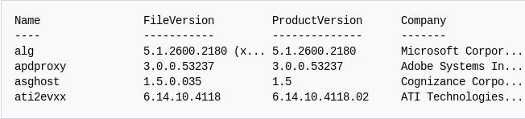
Get-Process

Slide 93
Windows Event Viewer
Window’s built-in way to view event logs
Beware of lots of information, warnings, and errors
Information - program reporting information of its execution
Warning - not necessarily significant, but an issue might be about to occur
Error - probably a major issue
Default save location: C:\Windows\System32\winevt\Logs\

Slide 94
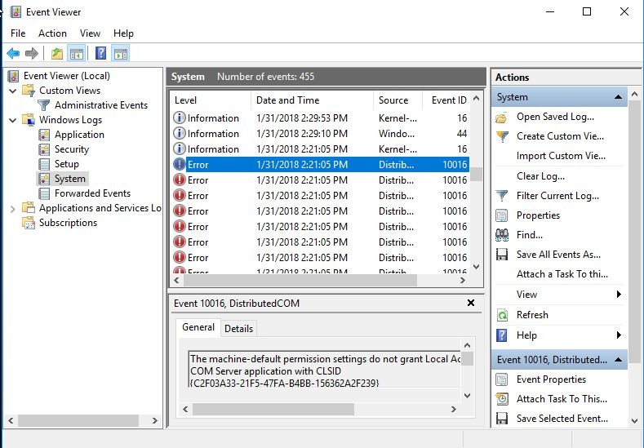
Windows Event Viewer

Slide 95
Windows Registry
Registry: “a system-defined database in which applications and system components store and retrieve configuration data” [2]
Stored in a tree structure, up to 512 levels deep
Utilizes standard access control (must have proper privileges to modify certain registry key values)
[2] Microsoft Registry Documentation

Slide 96
Important Windows Registry Keys
DisallowRun: prevent certain exe files from executing
fDenyTSConnections: disables Remote Desktop
restrictanonymoussam: prevent anonymous enumeration of SAM accounts and shares
RNG\Seed: seed used for random number generation
HKEY_CLASSES_ROOT\*: mapping of all known file extensions to programs

Slide 97
Tin Foil Hats in Windows
How to disable built-in tracking
Don’t use your microsoft account as login
“Local account” = less tracked account
Disable associated services that keep track of location, what websites you have visited, etc.
Limit which apps can utilize camera, location, microphone, etc.

Slide 98
Active Directory

Slide 99
What is Active Directory?
Active Directory - a directory service that keeps track of users and systems within the network
Utilizes domains - computer network with all user accounts, systems, and security policies registered within a central database
Basically a service that allows administrators of Windows networks to manage users who need the ability to access multiple services/systems across the network

Slide 100
Why do I need to know about Active Directory?
Almost every major company and government agency has at least 1 Windows domain that utilizes AD
For blue or red team roles, being comfortable with Active Directory management can be invaluable
Windows dominance within the corporate computing industry will not be going away anytime soon

Slide 101
Active Directory Components
Domain Controller: server(s) running the Active Directory Domain Services (AD DS)
AD DS keeps data in a tree structure that can be accessed using LDAP
Authentication handled using Kerberos
Samba for network shares
Usually includes DNS server, WSUS, Exchange email server, network shares

Slide 102
Active Directory Structure
Active Directory uses tree structures to keep track of users and the categories they fit in

Slide 103
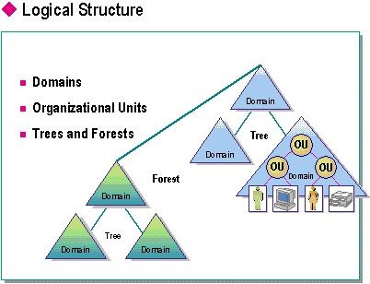
Active Directory Structure

Slide 104
Group Policy
Group policy - centralized management and configuration of user/system accounts
Helps to enforce user/group access control across the network using rules
Group Policy Object - set of Group Policy rules
Import/Export GPO in order to have standardized rules throughout multiple domains

Slide 105
Group Policy
Group Policy Preferences - settings that are preferred by the admin, but not enforced
CAUTION: The Group Policy Preferences AES key that is used for encrypting passwords within the Preferences Policy file is publicly available through Microsoft

Slide 106
Threat Protection

Slide 107
Updates to Microsoft Security Tools
Fortunately, Microsoft has updated most of its security suite
Unfortunately, this means most of the old tools don’t work anymore

Slide 108
Defender Security Center
Aggregates most security features in a single application
Firewall
Antivirus
Application Protection

Slide 109
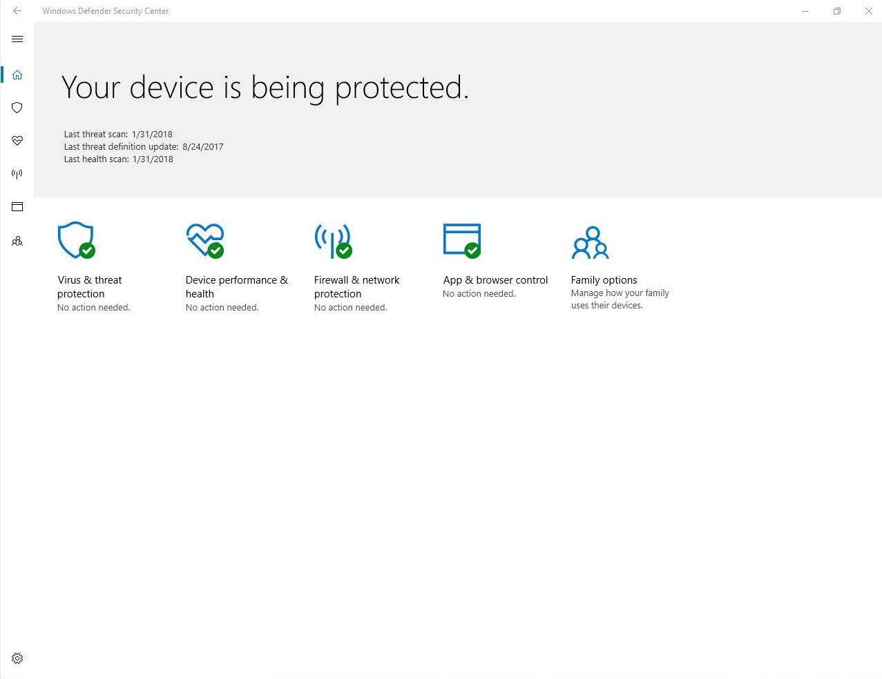

Slide 110
Defender Exploit Guard
New product designed to be close to a built in HIPS System
Replaces EMET
Exploit Protection
Attack Surface reduction
Network Protection
Controlled Folder Access

Slide 111
Exploit Protection
Customizable in Defender Security System
Data Execution Protection
Control Flow Guard
Address Space Layout Randomization
Various App Level protections

Slide 112
Attack Surface Reduction
Disables potentially malicious behaviors
“Block executable content from email client and webmail”
“Block Office applications from creating child processes”
No custom rules
Can be applied in audit and block mode

Slide 113
Network Protection
Block outgoing traffic to malicious domains
Can’t pick what domains are on that list
Can be applied in audit and block mode

Slide 114
Controlled folder access
Marketed as ransomware protection
Allows folders to be marked as “protected”
Protected folders can only be modified by whitelisted programs
Program whitelist can be configured in Defender Security Center

Slide 115
Windows Defender Playground
Microsoft provides “malicious” applications to test Exploit Guard and Antivirus
https://demo.wd.microsoft.com/

Slide 116
Windows SmartScreen
Scans websites for malicious behavior
Scans downloaded files for malicious behavior
Warns user if anything unusual is detected

Slide 117
Defender Application Guard
Can’t be run in a VM easily :(
Windows 10 only
Runs Internet Explorer/Edge in a HyperV container if the website is untrusted
Supposedly doesn’t share the kernel

Slide 118
Event Forwarding
Finally?
Replaces features provided by Sysmon
Sends events to a Windows Event Collector

